Slide 1
Introduction to artificial intelligence
Technical University of Kosice
Faculty of electrical engineering and informatics
Computer modelling

Slide 2





Logistics
Have a machine with sufficient computational resources for training small neural networks and/or google colab account
Have programming experience from previous classes (python/c)
Now
After course

Slide 3

Course philosophy
Nobody should be left behind
Use available resources (presentations, discussions)
Create a chat room (teams / discord)
E-mail me anytime
No-cheating
No smartphones
No wrong questions
If under stress reach to me

Slide 4
Course Objectives
Understand theory behind neural networks
Build your own neural network components from scratch
Transition to high-level api in pytorch/pytorch lightning
Create algorithms for different tasks

Slide 5
Project & exam
Project (40b)
exam (written + oral) (60b)
Literature:
Goodfellow, I., Bengio, Y., a Courville, A. (2016). Deep learning. MIT Press. http://www.deeplearningbook.org
Kvasnička, V., Beňušková, Ľ., Pospíchal, J., Farkaš, I., Tiňo, P., a Kráľ, A. (Year). Úvod do teórie neurónových sietí
Exam will test your understanding. It does not have to be covered here in presentations. Reading additional literature is required.

Slide 6
Questions?

Slide 7
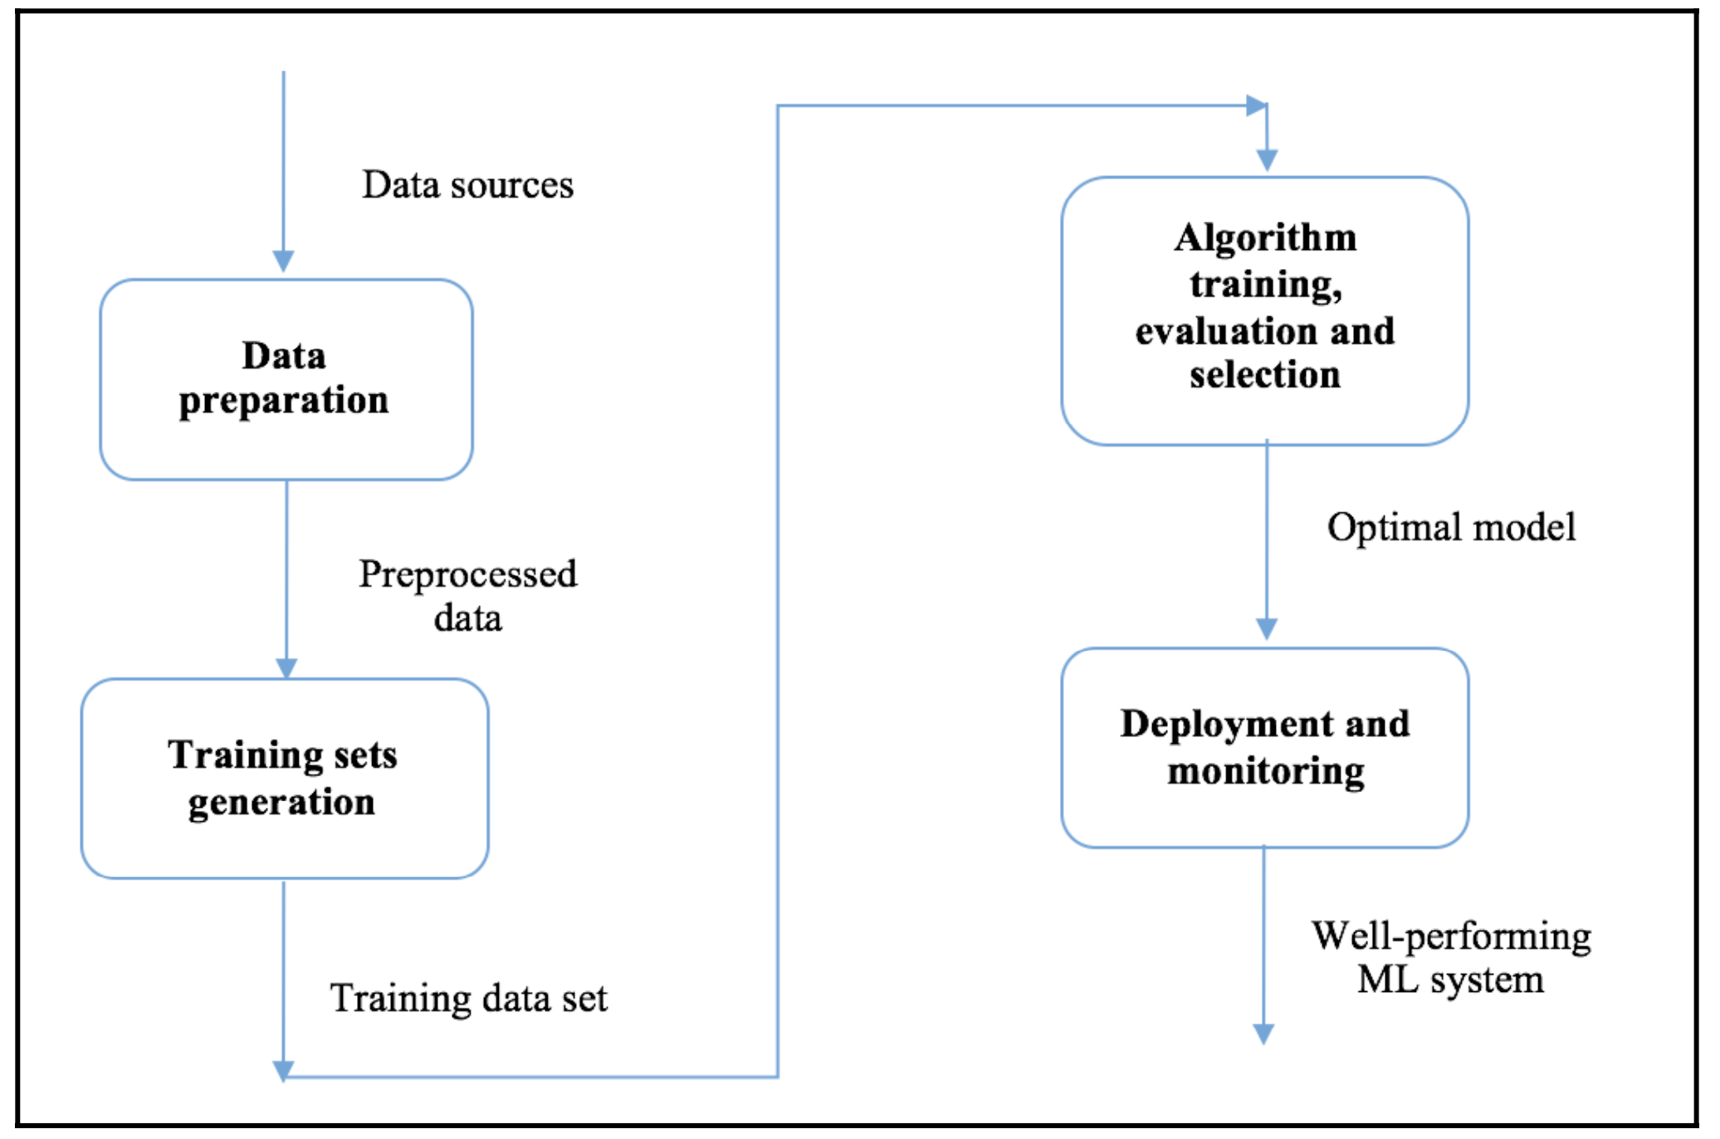
Process of model iterative development

Slide 8
History
Mathematic optimization
1952
Stochastic Gradient Descent
1986
Backpropagation
2012
AlexNet
&
ImageNet competition
2017
The Transformer Architecture (GPTs)
1943
McCullogh-Pitts
Neuron
1958
Multilayer Perceptron (MLP)
2014 Generative Adversarial Networks (GANs)
2016 AlphaGo
Learnable weights
Traditional Machine Learning Approaches
Neural Network Approaches

Slide 9
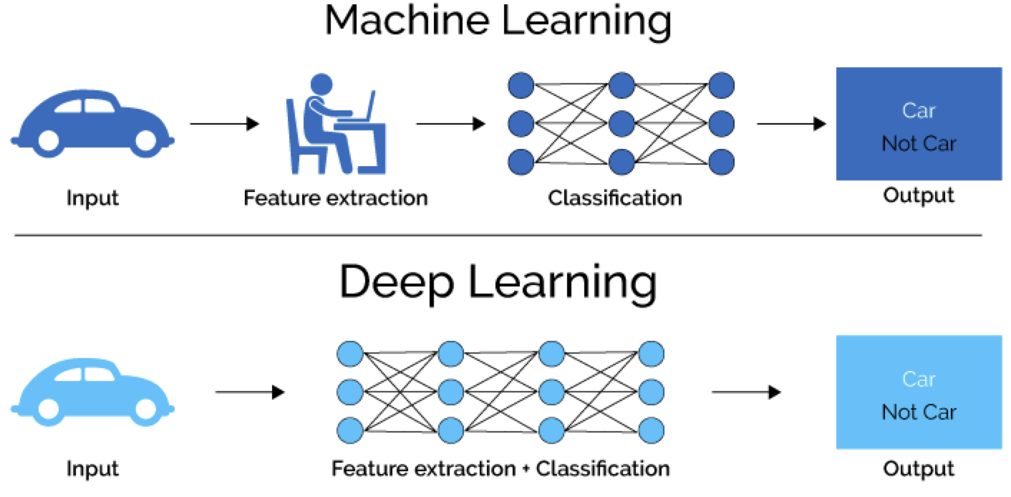

Traditional vs neural approaches
Traditional
Neural
Classify cars
Classify cars
Gather large-scale data
Extract features manually
Annotate (car = 0, truck = 1, suv=2)
Feed a model
Get Prediction
Gather large-scale data
Annotate (car = 0, truck = 1, suv=2)
Feed a model
Get Prediction
Handcrafted features
Number of tires
Color
Size
Height
Traditional Machine Learning models required handcrafted features.

Slide 10

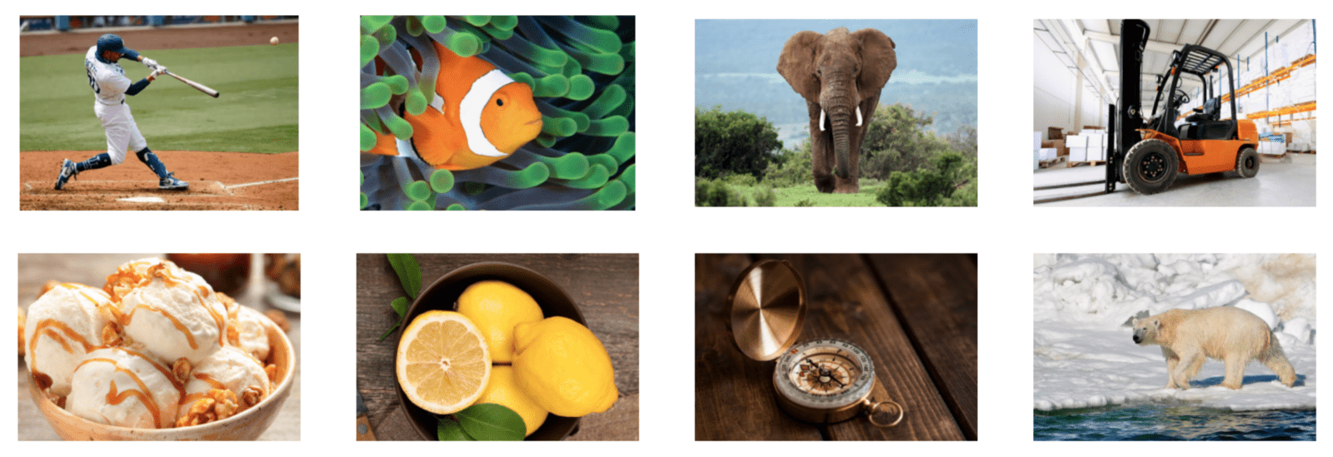

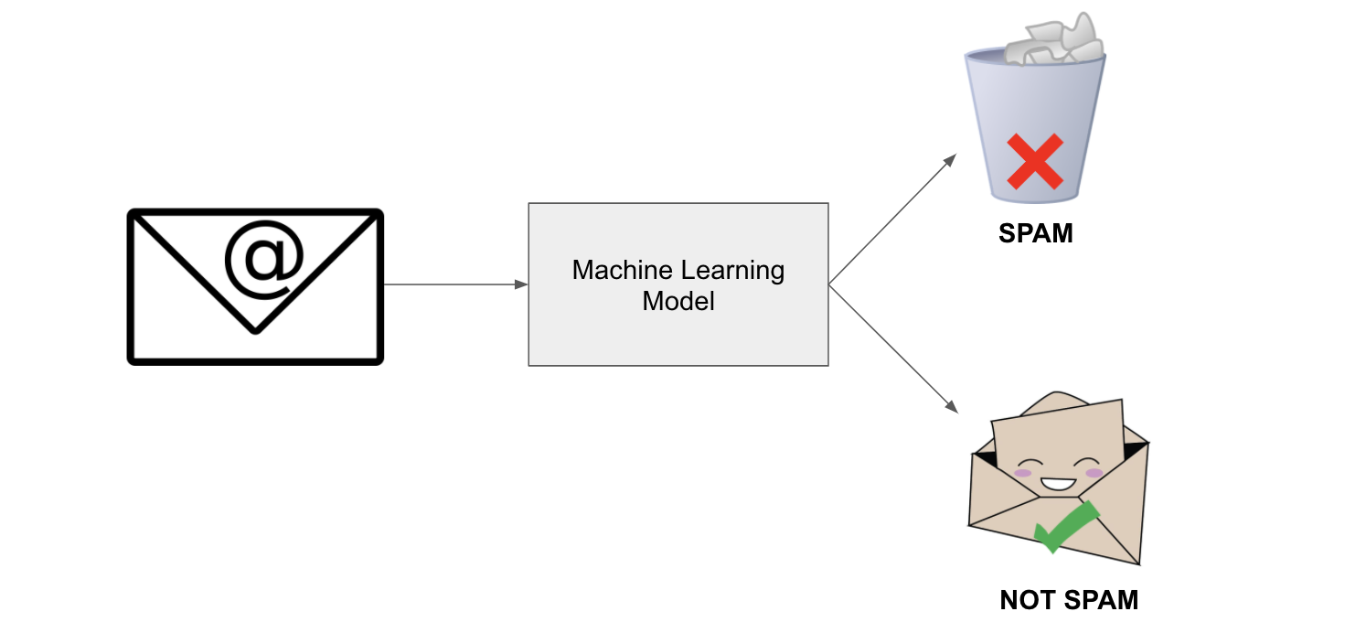
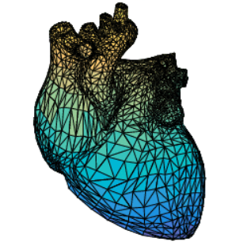
Data
Time series
Image
Text
Video
Meshes (computer graphics)
Image Classification (ImageNet)
Time series forecasting
Text Classification
Video Classification
Mesh

Slide 11
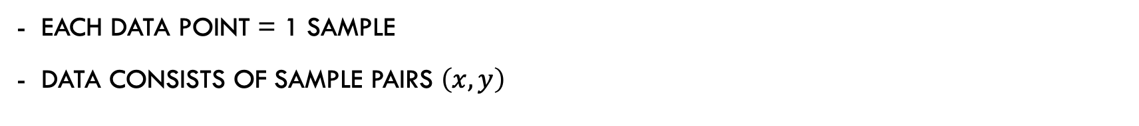
notation
Each data point = 1 sample
Data consists of sample pairs $\left(x,y\right)$

Slide 12
Types of prediction tasks
Binary classification (e.g. healthy/sick)
Multiclass classification (different illnesses)
Multilabel classification (multiple illnesses)
Regression (brain age from mri image)

Slide 13

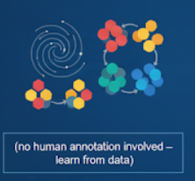

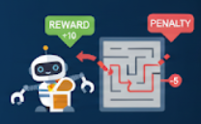
Learning types
Supervised (human annotations needed)
Unsupervised (no human annotation involved – learn from data)
Semi-supervised (learn from human annotation as well as from not-labelled data)
Reinforcement learning (learn by itself)

Slide 14
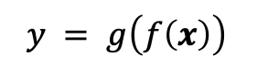
Perceptron – forward function
x₁
w₁
x₂
w₂
Activation Function
∑
Output
w₃
x₃
$$y = g\left(f\left(x\right)\right)$$
w₄
Non-linear activation function
x₄
Input
What is here non-essential?

Slide 15
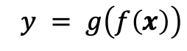
MultiPerceptron – forward function
x₁
∑
x₁
x₂
∑
Activation Function
Output
x₃
$$y = g\left(f\left(x\right)\right)$$
∑
x₃
Non-linear activation function
x₄
Input

Slide 16
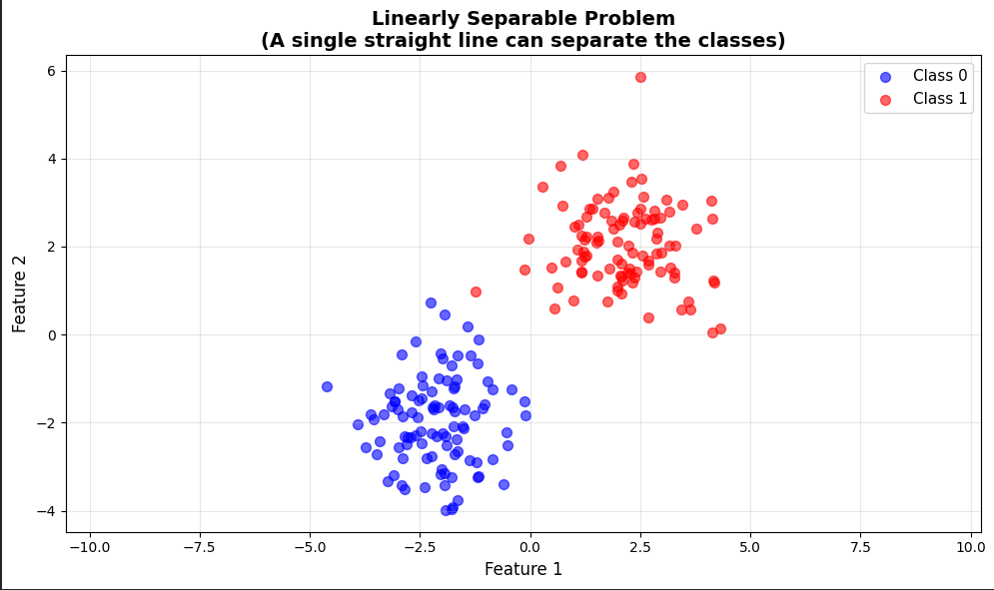
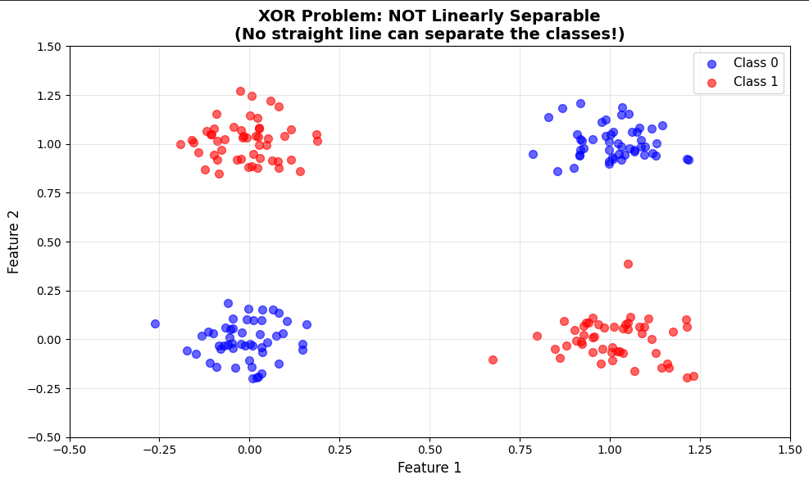
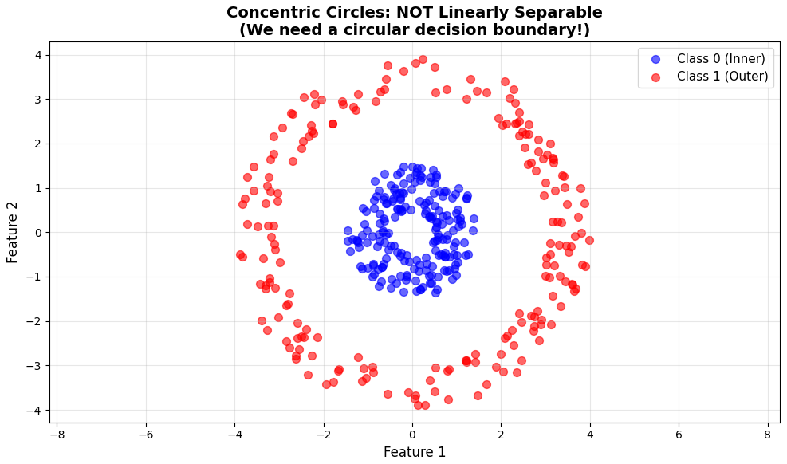
Do we need activation function?

Slide 17
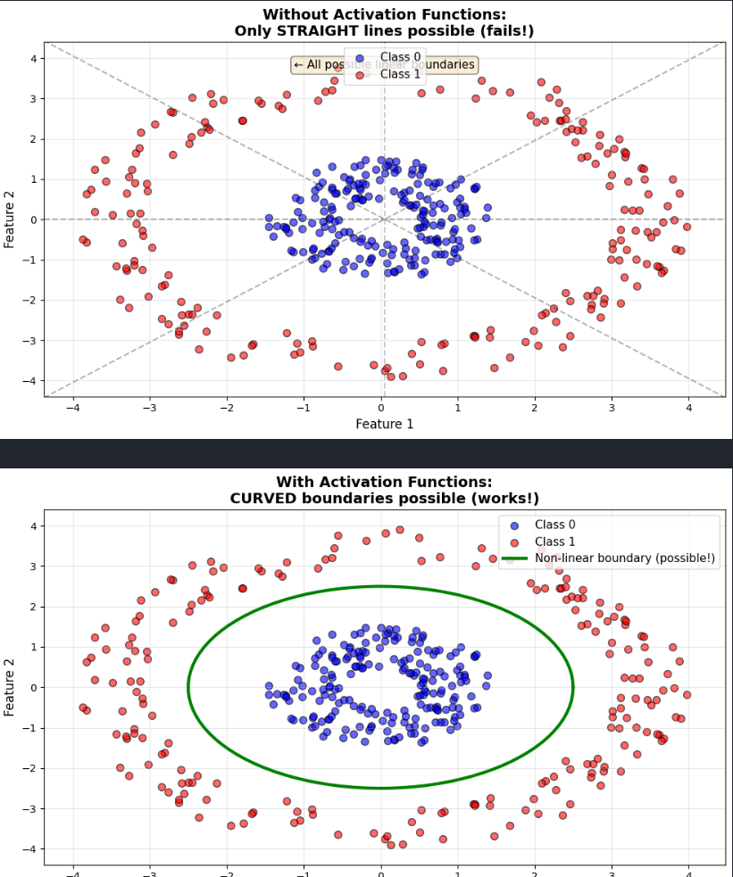
Do we need activation function?
MATHEMATICAL PROOF: Stacking Linear Layers Without Activation
Consider a 2-layer network WITHOUT activation functions:
Input: x ∈ ℝ²
Layer 1: h = W₁·x + b₁
Layer 2: y = W₂·h + b₂
Substituting h into the second equation:
y = W₂·(W₁·x + b₁) + b₂
y = W₂·W₁·x + W₂·b₁ + b₂
y = W·x + b
Where W = W₂·W₁ and b = W₂·b₁ + b₂
CONCLUSION: Multiple linear layers = Single linear layer!
✗ No matter how many layers you stack, you can only learn LINEAR
decision boundaries (straight lines, planes, hyperplanes)
✓ With activation functions, each layer can learn NON-LINEAR
transformations, enabling complex decision boundaries

Slide 18
Lab 01: aims
Aims
Create perceptron in numpy
Create perceptron with activation function
Create multi-layer perceptron in numpy
Load dataset for classification of diabetes
Train the model for classification of diabetes
Interpret results

